Slide 1

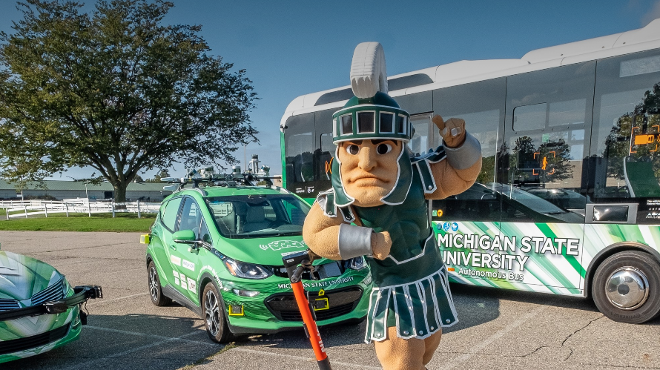
MSU Mobility
Notes:
Before we get into the “what” and “how” questions that explain MSU Mobility, let’s begin with the “why” and a definition to level-set our mutual understanding of the universe “mobility” constitutes.
“Mobility” refers to the technologies and services that enable people and goods to move more freely. This is inclusive of the devices, the making and operations of vehicles of multiple modalities, workforce adaptations, infrastructure systems, business opportunities, behavioral issues, and the regulatory and legal frameworks that support how humans and things move from A to B both now and in the future. When we say “enable moving around more freely” we mean ways that improve the safety, sustainability, accessibility and equity of all of these things.
Neat, but ‘why’?
The mobility sector is far and away Michigan’s largest and most important economic sector.
The industry directly and indirectly employs 1.2 million jobs – 20% of Michigan’s employment / 1 out of ever 5 jobs in the state.
The mobility sector accounts for $83 billion in compensation (salary + benefits), paying an average salary of $71,547.
It generates $348 billion in gross economic output. This equates to roughly 27% of Michigan’s total economy.
The industry supports over $14 billion in state and local tax revenues.
There is not another industry in Michigan that comes anywhere close to our Mobility sector in any of these categories.
As MSU jockeys to be the “university for the state of Michigan”, growing our role in the state’s most important sector cannot be understated. In fact, it is directly tied to our achieving the goals in the MSU 2030 strategic plan, including:
Improving 6-year graduation rates by 5% by 2030.
Increasing the number of faculty/staff prestigious academic awards by 15% by 2030.
Expanding MSU’s capacity for local and global impact by reaching $1 billion in annual research expenditures by 2030.
Enhancing the quality of life for people everywhere by leveraging research activity to improve systems that affect health.
Reducing the university’s GHG emissions by 50% (from the 2010 baseline).
Advancing equity by eliminating racial and ethnic opportunity gaps.

Slide 2





















What is all in MSU Mobility
Engineering
Administration & Operations
Business
Natural Sciences
Law
Agriculture & Natural Resources
Education
Social Sciences
Communication Arts & Sciences
Notes:
Continuing on the “why” and translating that into the “what”…
The Mobility sector has evolved significantly from yesteryear’s traditional Automotive and Transportation sectors to have a more holistic view of the movement of people and goods across land, sea, space and air in ways that are increasingly more sustainable, accessible, equitable, smarter, connected, efficient, customizable, and safer. What used to be an industry that cared most about engine performance and pavement preservation, is now an industry that cares deeply about how software can improve the mobility experience, machine learning and AI, the Internet of Things and cybersecurity, the integration of multiple mobility modalities into the energy grid and telecommunications systems, the environmentally conscious use of rare Earth materials and their supply chains, and how new technologies will be accepted by society and governed by new legal frameworks.
This shift into a more macro-lensed and technologically-based industry presents both a massive challenge and opportunity for Michigan State University. MSU must not only adapt to the change to continue conducting relevant work in what is Michigan’s largest economic sector, but the incorporation of more subject matters into the value chains of today’s Mobility industry represent some of the largest and most impactful growth prospects for the research and career fields of future Spartans. But approaching all this more holistically requires new coordination techniques and modes of operations to get it right, as well as a redefined set of goals and strategic planning to achieve them. This is what MSU Mobility was founded to do.
MSU Mobility is our platform for coordinating mobility initiatives across several colleges and with a variety of facets of the university’s administration and operations. These initiatives fall generally into four categories: growing mobility relevant research (which is MSU Mobility’s primary focus), enhancing MSU’s role as a mobility talent pipeline, modernizing campus operations and the MSU mobility testing environment, and supporting mobility tech transfer activity.

Slide 3
How MSU Mobility’s efforts to do “more” mobility at MSU take shape.
Marketing & Communication Services
Internal Coordination
Industry & Government Networking
Research Portfolio Growth
Brand exposure
Message amplification
Strategic visibility in trade news/forums
Subject matter expert placements
Greater awareness of publications
Event/Conference presence & speaker opportunities
Enabling holistic, systems-level research.
Common goal setting.
Greater awareness for university-wide mobility initiatives and research
Cross-pollination of ideas, projects, intel networks & funding opportunities.
Enhanced mobility services & infrastructure capabilities on campus.
Market insights & sounding boards
Introductions and partnership opportunities
Participation on advisory boards
Commercialization and societal impact
Access to more joint ventures and licensing opportunities
Translation of partnership opportunities into sponsored research
Increased volume & value of multi-disciplined research.
Strengthening of research portfolio through diversification.
Notes:
So “how” exactly does MSU Mobility go about being a platform for growing our mobility relevant research, solidifying our role as a human resource supplier of skilled talent for the Michigan mobility industry, modernizing our campus operations and the MSU mobility testing environment, and supporting mobility tech transfer activity?
First, MSU’s College of Engineering, with the foresight that doing “more” with advanced mobility would be a rising tide that lifts all boats at the university, attracted one of the chief architects and co-founder of the State of Michigan’s Office of Future Mobility & Electrification. At OFME, one of Judd Herzer’s primary roles was to coordinate mobility initiatives between several state departments including economic development, workforce, transportation, energy and environment, natural resources, insurance, regulatory affairs, and law enforcement, sometimes even acting as a Mobility diplomat of sorts engaging several states in the Midwest region around certain mobility efforts. Now, as MSU’s Mobility and Innovation Director, Judd is paving the road for MSU’s own unified, cross-college approach to Mobility. In addition to managing the administrative and operational aspects of MSU Mobility, Judd also acts as a leading voice for all things mobility at MSU – representing the university’s mobility efforts in the media, at conventions, on boards, and in business partnerships – ensuring the Green and White colors are more consistently flown and seen in Mobility circles. Our relevance and ability to do “more” being directly related to the perception of us within these circles.
Next, MSU Mobility has established the university’s first systematic method for internal coordination around mobility. The MSU Mobility Collective Organization for Research and Engagement (AKA MSU Mobility CORE) was created to facilitate sharing of mobility efforts and subject matter expertise internally. The group meets regularly with representation from the several colleges and of VPRI, IPF, DPPS, RCPD, AUTTC, MSU Technologies, Business Connect, Spartan Innovations and the MSU Research Foundation. In addition to building greater awareness and sharing of best practices, expertise, and resources to improve mobility initiatives, the MSU Mobility CORE has also been hard at work developing MSU’s first ever Strategic Plan for Mobility: setting baseline data, crafting short- and long-term goals, and identifying appropriate tactics to help MSU be better situated in 3-, 5- and 10-years from now with respect to our position in the Mobility economy.
As part of these efforts MSU Mobility conducted the painstaking task of creating MSU’s first ever Mobility research project inventory that identifies the number and value of mobility projects, the faculty involved, the sponsor source, and area of research. While establishment of a more refined, continuously updated, and searchable database is still in the works this initial, rudimentary project inventory system offers the ability to analyze a number of things we previously could not, including: (1) our own comparative rankings, in terms of projects' value, number of projects, number of researchers, number of partners, and areas of expertise; (2) capacity of the research team and which areas represent growth opportunities for us; and (3) what additional tools (equipment, marketing research, research areas) are in need of strengthening in order to support our competitiveness.
MSU Mobility has also established the university’s first ever collaborative system for Mobility related marketing and communications. Bringing together communications leaders from University Communications and several colleges on a regular basis to communicate with each other about the types of storytelling and newsworthy announcements, pitches, and promotional activities are happening across the MSU landscape. Breaking down these silos has enabled cross-promotion and amplification of our own messaging. MSU Mobility also created the university’s strategic communications plan for Mobility alongside University Communications, setting our communications goals and identifying the audiences, media outlets, and deliverables by which we intend to improve our messaging. MSU Mobility’s marcomm arm also maintains an evergreen Mobility communications calendar and is in the process of launching a new MSU Mobility website, social media, and other tools to improve our reach and attract more engagement from the Mobility sector to MSU. These professionally managed and modern communications tools will not only broaden our audiences, but they’ll provide us valuable analytics about what news and messaging is attracting valuable engagements and from whom; allowing us to get smarter about how we talk about Mobility at MSU. MSU Mobility is also currently working alongside the MSU Research Foundation to host an inaugural MSU Mobility Summit in August 2025 that will feature some of our proudest and unique Mobility research capabilities and shiniest startup examples. All of this will lead to a louder and more consistent drumbeat of Mobility news coming out of MSU.
Early results are in, and in the two years MSU Mobility has been operating full time we’ve:
Generated 112 unique mobility media publications and news stories,
Conducted 411 individual meetings with mobility sector partners, and
Attended or spoke at 46 mobility sector events, conferences, and roundtables.

Slide 4




MSU Mobility Strategic Plan Summary
MSU Mobility Strategic Plan Summary (draft)
Vision Statement:
Through an unmatched approach to holistically and collaboratively solving problems and developing talent, MSU Mobility is revolutionizing research and testing of transportation technologies and processes to catalyze the economy and boldly enable the mobility future of people and goods, from first mile to last mile, all across the globe.
Mission:
MSU Mobility harnesses cutting-edge technologies and a range of academic disciplines to pioneer safer, more equitable, sustainable, and accessible to all multi-modal transportation solutions that advance society, drive the economy forward, and better prepare mobility leaders of tomorrow.
Pillar 1: Developing Multidisciplined Mobility Talent
Pillar 2: Collaborative Mobility Research
Pillar 3: Improving MSU Mobility Operations & Infrastructure
Pillar 4: Advance Society & Catalyze the Economy
To support student success, become a top destination for mobility related experiential and high-value learning opportunities.
Retain #1 status as top producer of mobility talent for Michigan.
Become industry’s greatest ally in the talent supply chain by creating new mobility related academic programs focused on multidisciplinary curriculums.
Grow MSU Mobility research expenditures by 10% by 2030.
Identify (then increase) the number of MSU faculty serving on mobility relevant government advisory boards/commissions.
Eclipse $20M in annual research expenditures by 2035.
Continue strengthening research portfolio through discipline diversification.
Lead in campus economics of transportation decarbonization.
Lead in autonomous and connected device deployment and evaluations to enhance transportation safety.
Improve the relevance of mobility lab spaces by re-envisioning MSU’s accommodations for corporate co-location opportunities.
Enable more high-quality active mobility options on campus.
Positively impact the economy through enhanced utilization of mobility technologies and systems.
Improve lives through mobility technologies
Notes:
As noted, through the collective input several colleges and some critical parts of the university’s administration, MSU Mobility has been leading the development our first-ever strategic plan for Mobility. A strategic plan for MSU Mobility is critical for defining our organizational goals and objectives, which will in turn guide and streamline our decision-making and budgeting, help our internal faculty and staff identify their role within MSU and the relationship between their performance and our collective success, and enhance stakeholder engagement by easing external communities’ ability to more readily understand MSU’s mobility capabilities and how to align our workstreams to find common ground and mutually beneficial partnerships.
Without a strategic plan understanding the current status of MSU Mobility and where it should or will head to next is impossible. We would be unable to determine what is important, how to strategically achieve it, and what pitfalls to avoid and distractions to ignore, and we’d be unable to articulate decisions or the rationale behind actions beyond opinions of what is subjectively considered valuable or not. Additionally, a strategic plan will assist with any subsequent identified need for change, else we risk having any change management process be viewed as arbitrary or uncommitted/temporary.
To be successful with this plan and the implementation of the vision to offer more holistic and systems-level approaches to mobility research across many disciplines, MSU Mobility will require consistent, reliable resourcing. At the urging of VPRI, MSU Mobility therefore has also been working with the several colleges involved to establish a new finance system for MSU Mobility, modeled after the budget systems for research centers, that is based on growth of our collective research portfolio. This is another reason why collective input and common sharing of the creation of the goals in MSU Mobility’s strategic plan is so vital.

Slide 5














MSU Mobility Advisory Council
Notes:
To help guide the MSU Mobility CORE in the creation of our strategic plan, MSU Mobility also manages the MSU Mobility Advisory Council. Made up of 13 distinct private and public side perspectives the Council ensures we always have one eye on the Mobility sector’s outlook in our goal setting and tactics development. The council has quarterly general meetings and operates Support Squads that meet more regularly on specific topics like: identifying new mobility research funding opportunities, and comparative campus mobility deployment and testing assets.
Members of the council are senior leaders of research, marketing, operations, sales, and sustainability from:
The Michigan Dept. of Transportation (Dept. Director Brad Wieferich)
MichAuto (Exec. Director Glenn Stevens Jr.)
Stella Automotive (VP Clint Crook)
Capital Region Airport Authority (President & CEO Nicole Noll-Williams)
Bosh (President – Americas Mobility Unit Paul Thomas + Manager of Mobility Strategy and Marketing Beth Silver)
Consumer’s Energy (Director of Renewable Energy and Electric Vehicle Products Jeff Myrom + Commercial EV Product Manager Bethany Tabor)
Ford (VP & Chief Sustainability Officer Bob Holycross)
US Army – Ground Vehicle Systems Center (Chief Scientist David Gorsich + Deputy Chief Scientist Talia Sebastian)
Volkswagen (Director of Connected Mobility Services Frank Weith)
Magna (Director of Research and Development Jim Quessenberry)
Alta eMobility (VP of eMobility Mike Bucci)
Ripple Effect (Founder & President Daryl Adams)

Slide 6
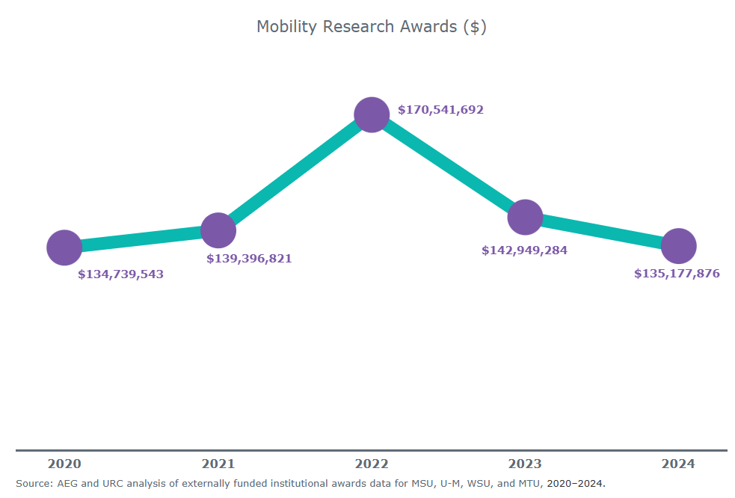
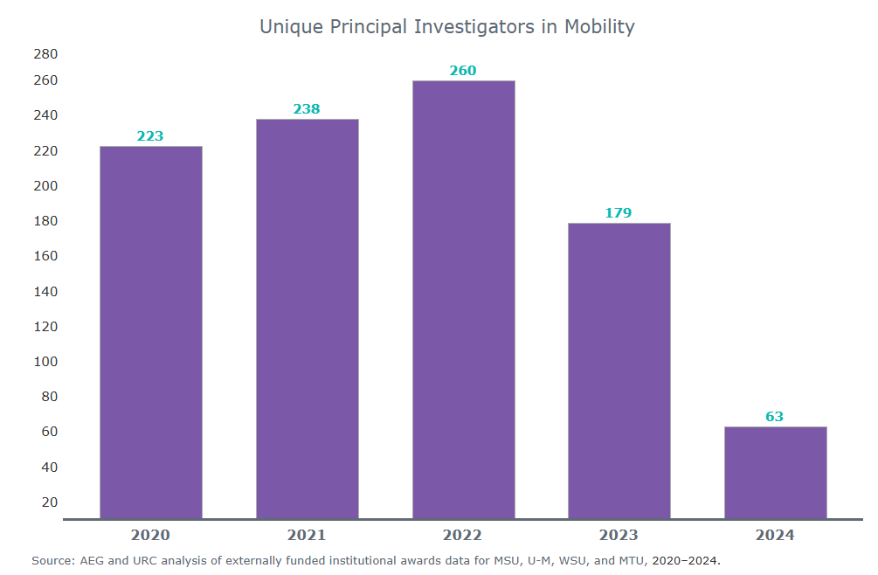
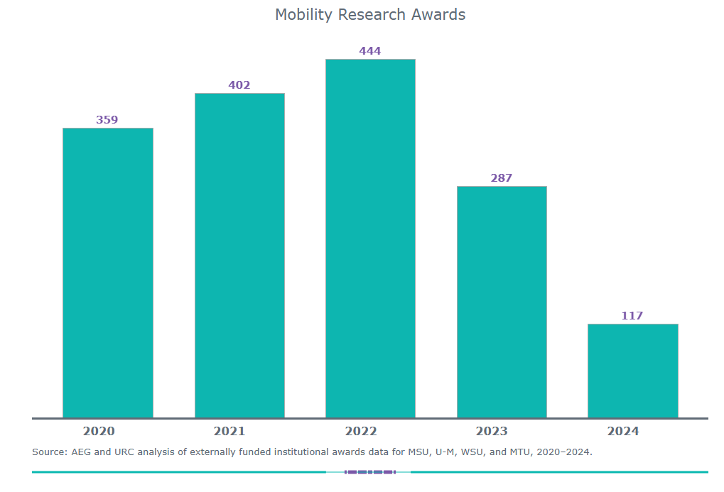
Research Universities for Michigan
Notes:
When it comes to Mobility relevant research, MSU does hold its own but the numbers show there’s work to be done if we’re to outpace our R1 counterparts in the state.
According to the recently rebranded Research Universities for Michigan, Michigan’s four R1s are helping shape the future of mobility through research. Sourcing data related to university’s mobility research has proven difficult as our universities do not all categorize and track our research by economic sector relevance the same way. But these numbers are useful for general baselining purposes.

Slide 7
Mobility Research Awards
Notes:
These numbers are from Research Universities for Michigan, and range from 2020-2024. It’s also important to note that multi-year projects will be counted once per year; these are not distinct projects RUFM is accounting for.
Our numbers don’t align exactly, but MSU Mobility’s first project inventory exercise produced 269 distinct projects from 2015-2023 – many of which were multi-year projects.

Slide 8
Research Universities for Michigan 2

Slide 9
Mobility Research Awards ($)
Notes:
When this data first came out (when RUFM was known as the University Research Corridor and included only MSU, UofM and WSU) the three R1 universities (including all three U-M campuses) conducted an estimated $565.86 million in mobility-related R&D from 2018-2022. At that time URC estimated the total for MSU over the same period was $89,143,003. At our collective peak in 2022, RUFM tallied a whooping total of $170 million in mobility research awards across Michigan’s now four R1s.
At MSU we’ve run our numbers slightly differently, but in 2022 for example, MSU’s mobility research expenditures (which is only a portion of each year of the total amount awarded) was north of $10 million. Perhaps more telling is that while RUFM’s numbers for awards declines after 2022, MSU’s mobility research expenditures have grown on an annual basis of 15% each of the last six years (2018-2025 – including the COVID impact).
MSU research expenditures breakdown:
2015 2016 2017 2018 2019 2020
F&A $407,451 $761,512 $1,245,097 $1,626,993 $2,097,234 $2,335,969
Direct $1,132,965 $2,070,143 $3,982,025 $5,091,176 $5,729,039 $6,609,799
Total $1,540,416 $2,831,656 $5,227,123 $6,718,169 $7,826,273 $8,945,768
Growth 84% 85% 29% 16% 14%
2021 2022 2023
$2,016,968 $2,405,358 $2,677,242
$7,044,231 $8,005,573 $9,310,009
$9,061,200 $10,410,931 $11,987,251
1% 15% 15%
2024 2025 2026 2027 2028
$1,749,541 $834,986 $480,588 $235,409 $79,972
$5,622,314 $3,015,146 $1,620,460 $658,344 $197,351
$7,371,855 $3,850,133 $2,101,048 $893,753 $277,324

Slide 10
Research Universities for Michigan 3

Slide 11
Unique Principal Investigators in Mobility
Notes:
Lastly, RUFM definitely counts the number of researchers working in the mobility sector differently than MSU does – limiting its numbers to those working primarily in engineering spaces. A total of 63 PI’s across all four of Michigan’s four R1s is a drastic underrepresentation. Across MSU’s eight colleges involved in Mobility efforts alone we have accounted for 77 individual researchers working directly on Mobility projects or in mobility-relevant technology fields. MSU also boasts 22 non-academic supporting positions.
At the end of the day, our people and not just their willingness, but their eagerness, to buy into our inter-disciplinary approach are what truly sets MSU apart from our contemporaries. Our unified strategic plan and comms efforts, and our shared goals and supportive environment make MSU unique when compared to not just UofM, WSU, and MTU, but to the R1 system nationwide.

Slide 12

Experiential Learning
Notes:
*Click Play button on slide* - When I played this video it was broken
In addition to research MSU Mobility is strategically supporting mobility relevant experiential learning platforms that lend to our goal of MSU being the Michigan Mobility sector’s greatest partner when it comes to talent development and filling current and future human resource needs. We see experiential learning as our key to achieving this goal since it not only teaches students practical application of their classroom theory learning, but because it also teaches them the soft skills they need to succeed in the workforce, like: teamwork, leadership, project management, deadlines and pressure, as well as a healthy attitude towards competition. Furthermore, there is no better academic platform for connecting students who are developing very translatable skills to Michigan’s most significant economic sector and with companies and engineers in the field to discover what career options the Mobility sector has to offer. It truly helps change their perception, for example, that automotive engineering is a polluting, metal bending business.
From sales and supply chain management programs at the Broad college of business that mobility companies are vested in, to developing interest in sponsoring a standing Mobility Law component of the Michigan State Law Review at the MSU College of Law, MSU Mobility sees hands-on, application- and project-based learning as a key distinction in the career-readiness of Spartan graduates.
At the College of Engineering, MSU has some of the best experiential learning offerings in the country for engineering students looking at the wide array of Mobility sector career fields. MSU Mobility has helped draw in corporate sponsorship of capstone projects. We’ve helped bring in funding and have helped market Engineering’s new TechE degree program. We’ve also supported MSU’s Baja, Formula-SAE, and Solar Car mobility racing teams. We are particularly proud of our work to make MSU Michigan’s first (and only) university participating in the Indy Autonomous Challenge. The IAC is an international motorsports contest that puts student teams with real Indy cars on real racetracks, competing on their abilities to code a vehicle to operate 100% autonomously in the most extreme automotive scenarios in the world. Whether it’s the excitement that comes with motorsports, traveling to race venues across the globe, or the accolades of the PoliMOVE-MSU team holding the Guiness Book World Record for fastest autonomous ground vehicle (197.7mph), the PoliMOVE-MSU autonomous racing team has exceeded our wildest expectations when it comes to a successful experiential learning platform. Our team grew from 0 to 22 students in our first month, and has doubled in size at the end of our first racing season. There is now a waitlist for students hoping to join the team!
Oh, and by the way – you’ll see the Indy cars in what we call “Tron-mode”. Unlike how the human eye requires light in our retinas to see, the LiDAR, RADAR, GPS, and specialized optical sensors on these Indy cars don’t, and it allows for the super cool aspect of night-racing autonomous vehicles.

Slide 13
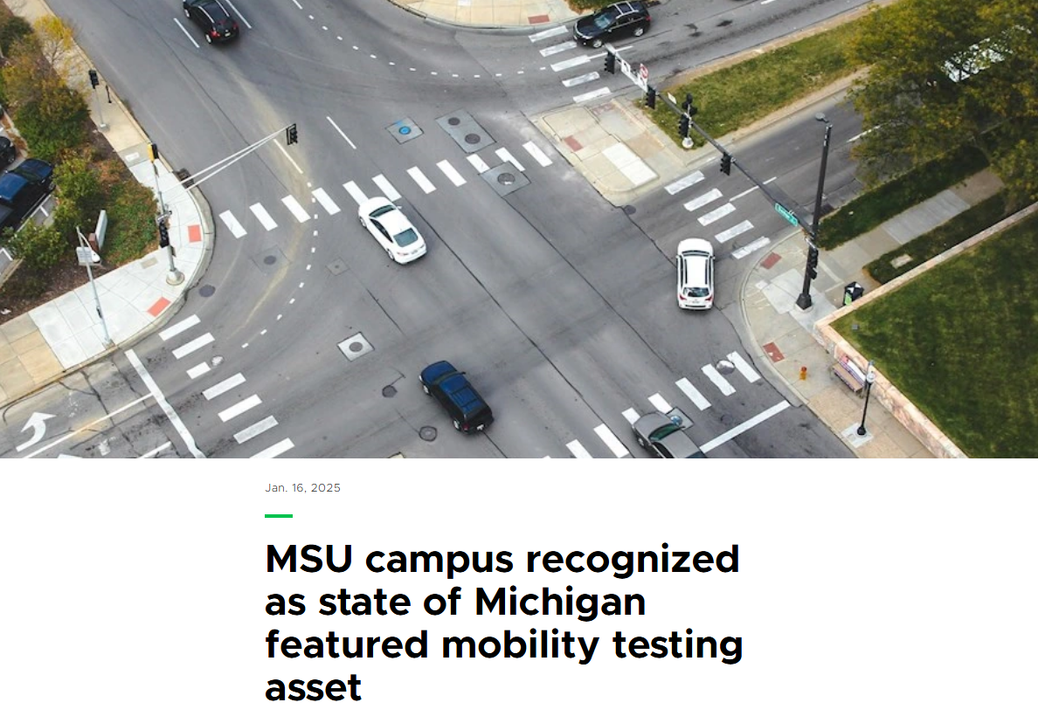
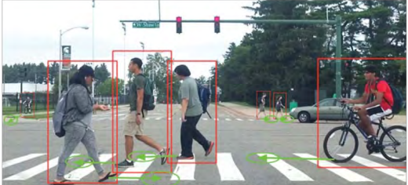
MSU Mobility Testing Environment & Campus Operations
Notes:
On campus whether its representation on the All-University Traffic and Transportation Committee (part of the MSU academic governance structure), advising IPF and DPPS when it was time to renew the University’s transit contract with CATA, or supporting the renewal of Spin Scooters’ exclusive operational rights on campus – MSU Mobility has been lending its hand to creating a more vibrant, safe, accessible, equitable and sustainable mobility ecosystem on main campus. In the last year, MSU Mobility was responsible for renewing the licensing agreement with ADASTEC Corp. to operate the autonomous bus on campus, which doubles as a transportation mode for students and a research platform for faculty. MSU Mobility has also supported the retirement of the university’s antiquated Digital Short-Range Communications connected vehicle roadside units and upgraded to new, modern Cellular Vehicle-to-Everything (CV2X) smart infrastructure systems. We’ve also contributed to the efforts to decarbonize the university fleet and deploy advanced EV charging technologies and make plans around future EV charging needs on campus. All of this activity culminated in a successful bid in 2024 to have MSU’s main campus recognized for the first time by the State of Michigan as an official mobility testing asset – making campus eligible to support certain state government funded technology activation and evaluation grants.
MSU’s campus boasts a phenomenal mobility product and service deployment and testing environment. Our 5,200-acre campus serves as a live, connected testbed ecosystem spanning 8.1 mi2 of contiguous urban, suburban, industrial and rural zones. That we own our own roads, electric grid, power generation and police departments make MSU an ideal, real-world location to test emerging technologies among a large, widely diverse population in all four seasons.
MSU Campus Details:
Nearly 60-lane miles of roads
More than 120 miles of pedestrian walkways and sidewalks
Nearly 20 miles of bike lanes
Nearly 40 traffic signals
Diverse population: 70,000 students and faculty; up to 100,000 people on a game day
545 occupied buildings
26,000 parking spaces
30,000 vehicles on campus per day

Slide 14
Thank you – closing slide
THANK
YOU
Notes:
Go Green!

